Slide 1
Lobster
File created on: 2024-01-11 11:14:49 a.m. AST

Slide 2
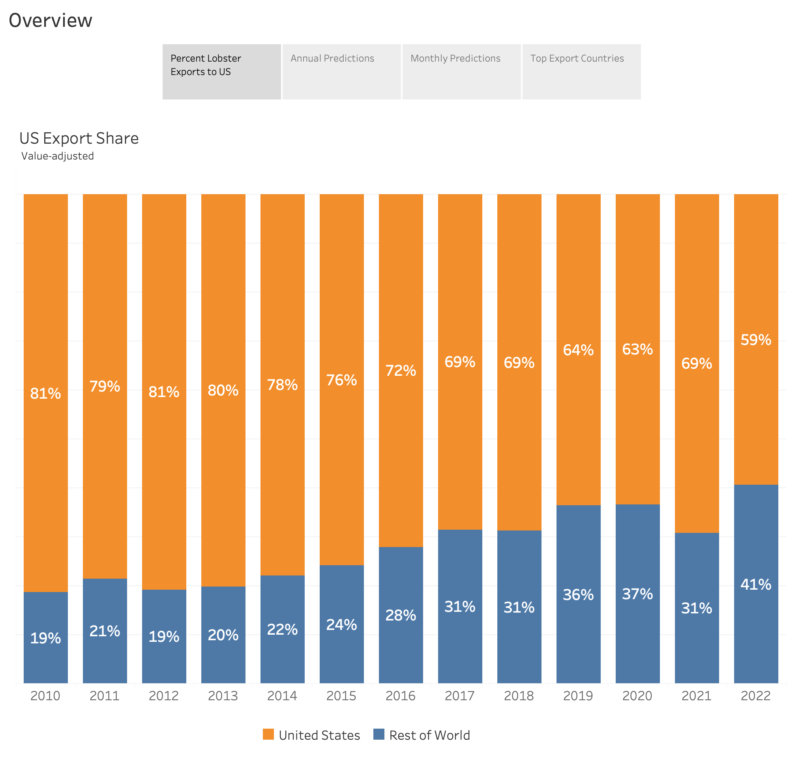

Slide 3
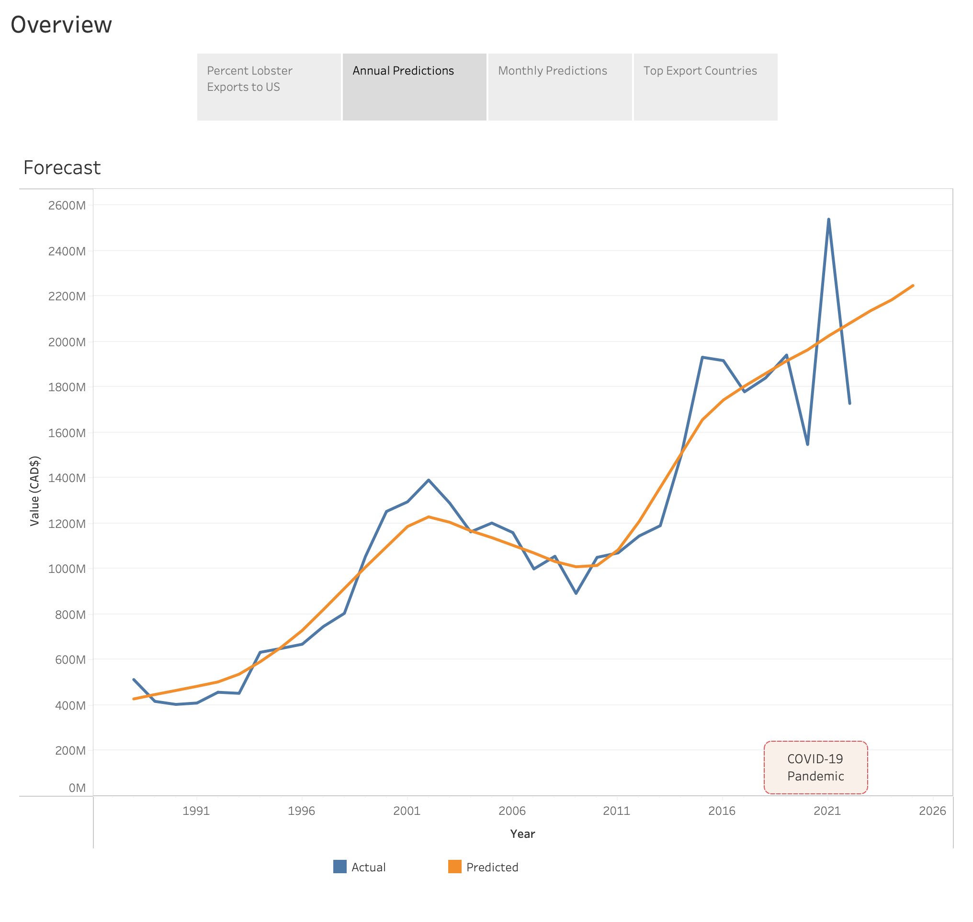

Slide 4
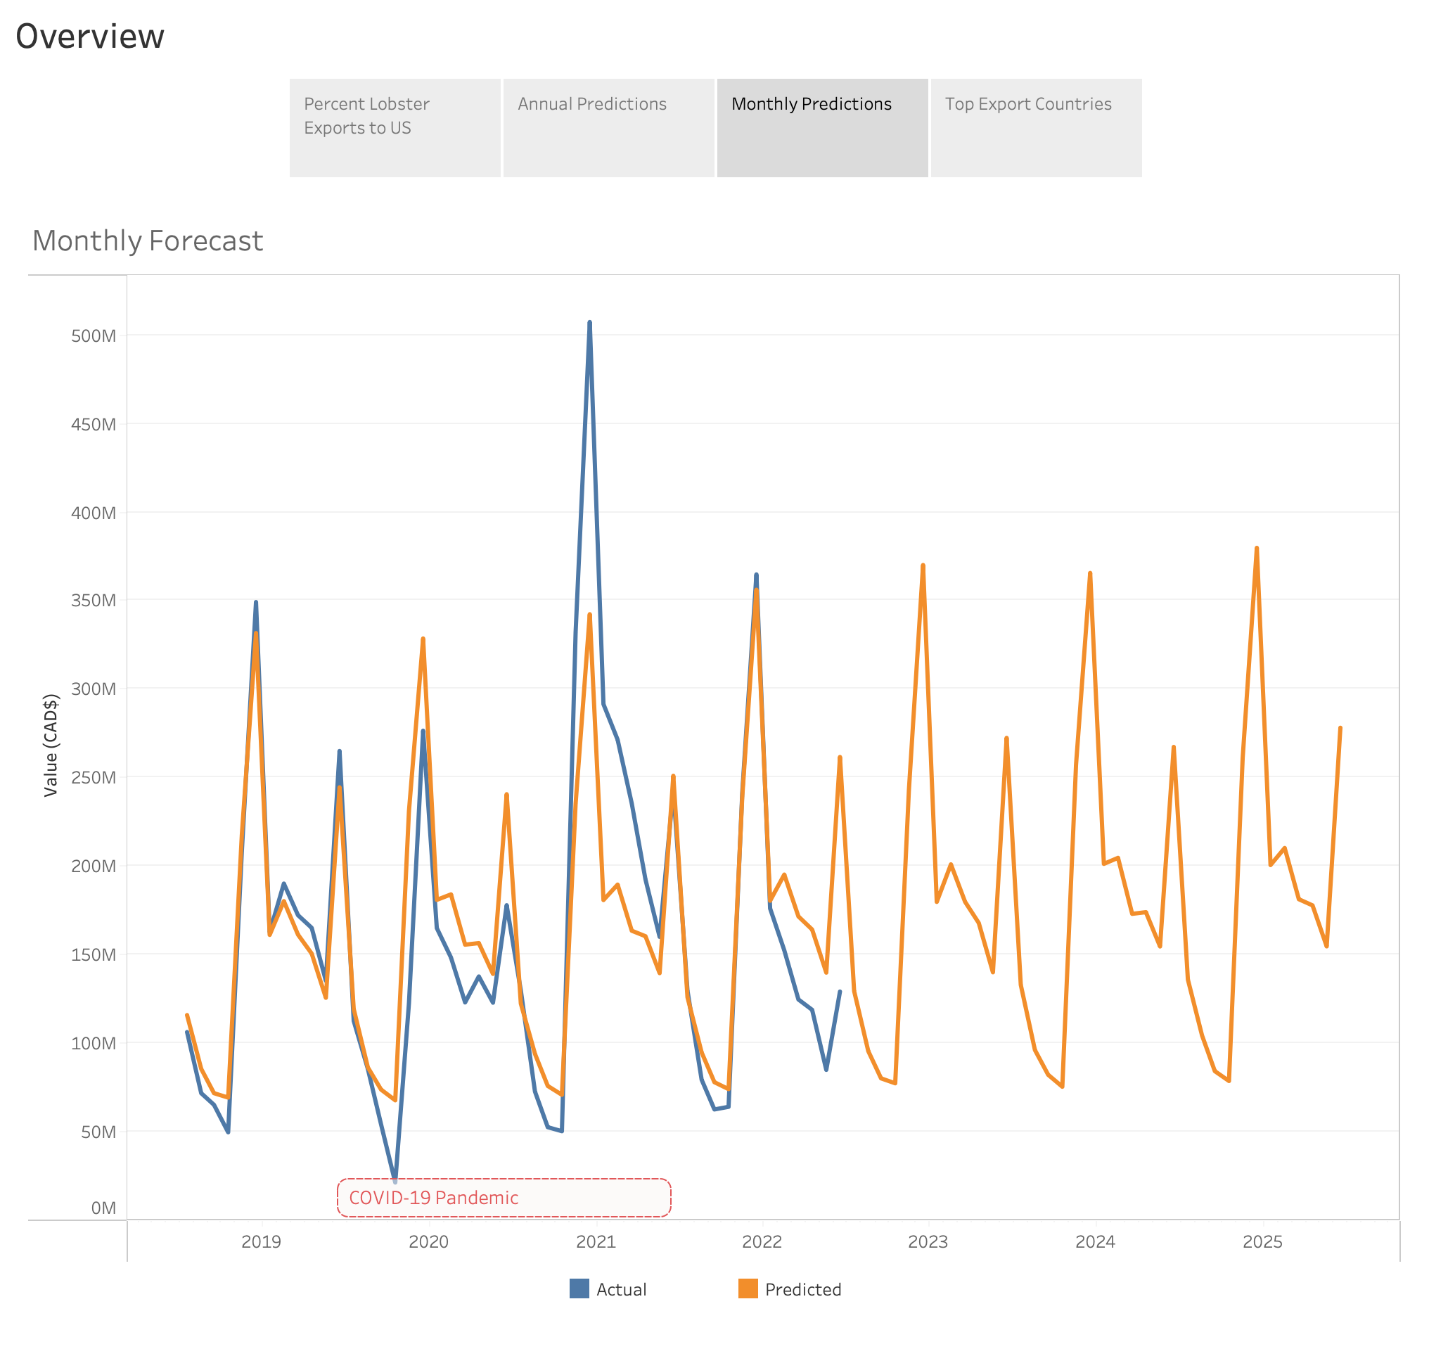

Slide 5
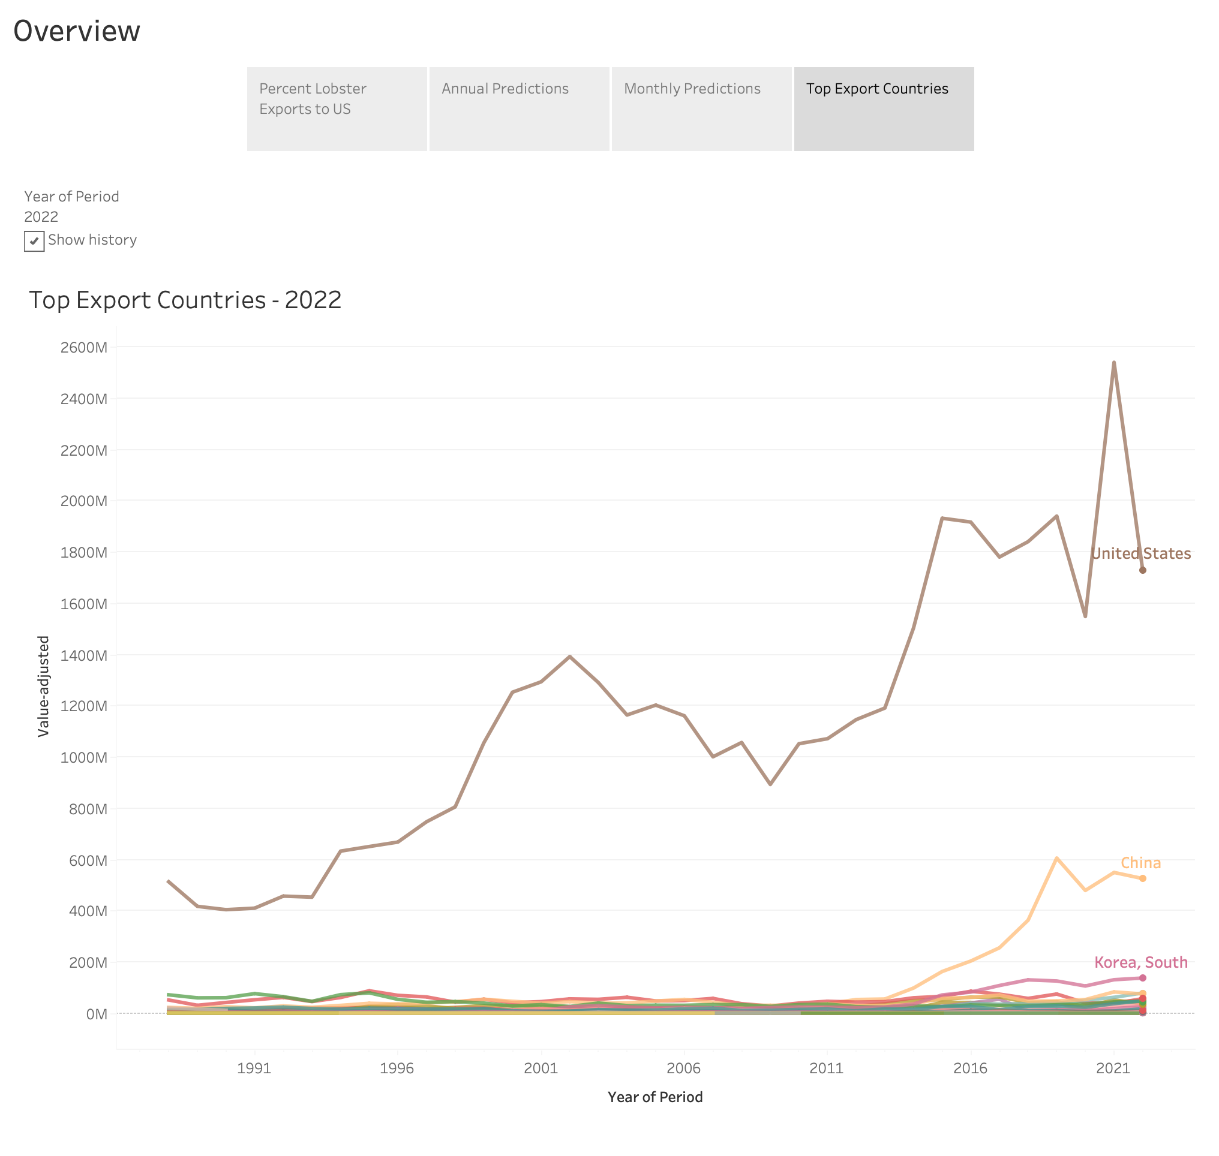

Slide 6
